Slide 1

Can Contracts Signal Social Norms? Experimental Evidence
Anastasia Danilov and Dirk Sliwka
Management Science, 2017, 63(2): 459-476.
Reporter : 孙凤飞

Slide 2
CONTENTS
Overall Introduction
Experimental Design
Results & Mechanism
Further Discussion

Slide 3
PART 1: Introduction
Authors
Background
Organization

Slide 4

Introduction · Authors
Anastasia Danilov
Assistant Professor
Humboldt-Universität zu Berlin
personnel and behavioural economics
unethical behaviour
incentives,
behaviour in teams
More information:
https://anastasiadanilov.de/.

Slide 5

Introduction · Authors
Dirk Sliwka
Research Fellow
University of Cologne
Behavioral economics
Compensition
Incentives
Management
Performance measurement
Personnel economics
More information:
https://www.iza.org/person/790/dirk-sliwka.

Slide 6
Introduction · Background
Social norms matter for individual behavior
There is uncertainty about prevailing norms in reality
New employee: need to gather information about behavior of collegues
——intrinsic tendency for conformity
Owners or managers: have information about observed vehavioral patterns and may change incentives using this information respectively.
Maybe overlook the effect of incentives

Slide 7
Introduction · Background
Direct effect of incentives v.s. Indirect effect of incentives
Indirect effect: contract choices may signal information about the actions of other agents and thus create indirect effects on behavior.
Formal economic model has proved this idea
Sliwka(2007), Friebel, and Schnedler (2011), van der Weele (2012) and Bénabou and Tirole (2012)
Conduct lab experiments to explore this idea

Slide 8
Introduction · Organization
Principals
Information about
behavior of others
Agents
Beliefs about
behavior of others
Principals
Incentives choice
Agents
Efforts level
More information see Sliwka(2007)

Slide 9
PART 2: Experiment
Design
Procedure
Addition

Slide 10
Experiment · Baseline Design
Strategy method
One-shot principal-agent game
Endowment: 6 Euro
Randomly matched in pairs
Principal (employer)
Agent (employee)

Slide 11

Experiment · Baseline Design
雇主选择激励机制
Fixed wage (trust compensation)
Performance-contingent pay (contingent conpensation)
雇员选择努力程度
Effort level : e between 0 and 100
Private costs

Slide 12
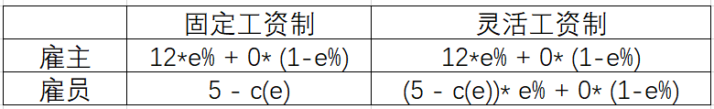
Experiment · Baseline Design
收益矩阵
均衡解
Second - best effort:
Trust pay: 0
Contingent pay:30
First – best effort:
Both :72

Slide 13
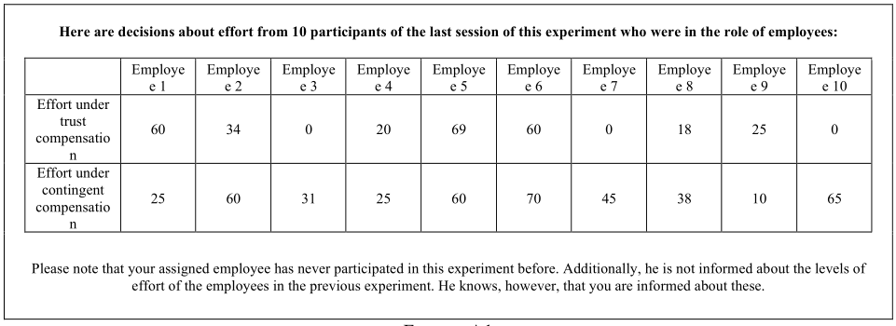
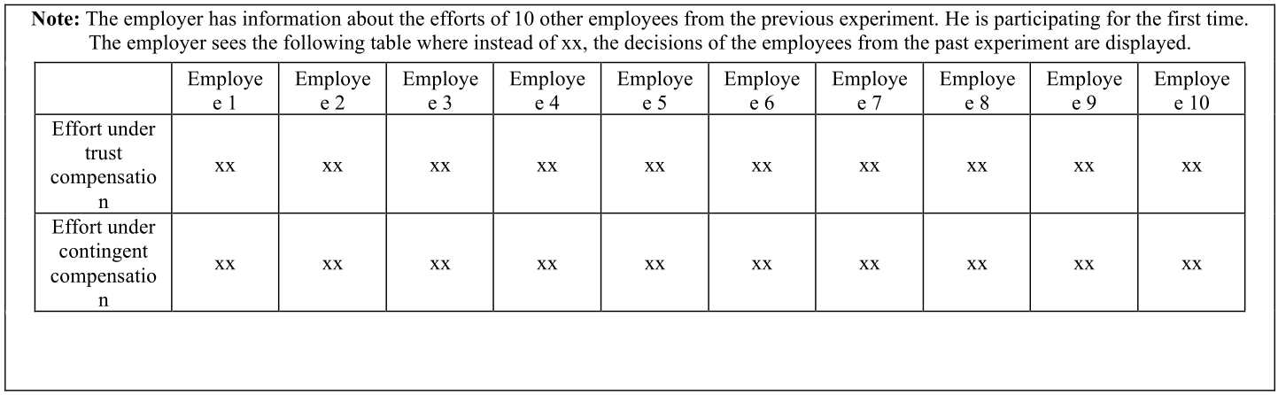
Experiment · Baseline Design
Treatment variation
Baseline treatment
Norms treatment

Slide 14
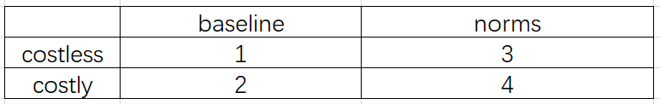
Experiment · Extended Design
2X2 组间设计
Costly treatment : additional costs of €2 when choosing the performance-contingent compensation, and the agents are aware of this information

Slide 15
Experiment · Procedure
25 sessions with 20 to 32 subjects each, 691 participants in total
A short quiz on the structure of the experiment and the computation of payoffs
Decision stage
anonymous and no communication was permitted
the Laboratory for Experimental Research of the University of Cologne
zTree (Fischbacher, 2007)
€12.55 earnings on average

Slide 16
PART 3: Results & Mechanism
Efforts level
Efforts distribution
Three premises

Slide 17
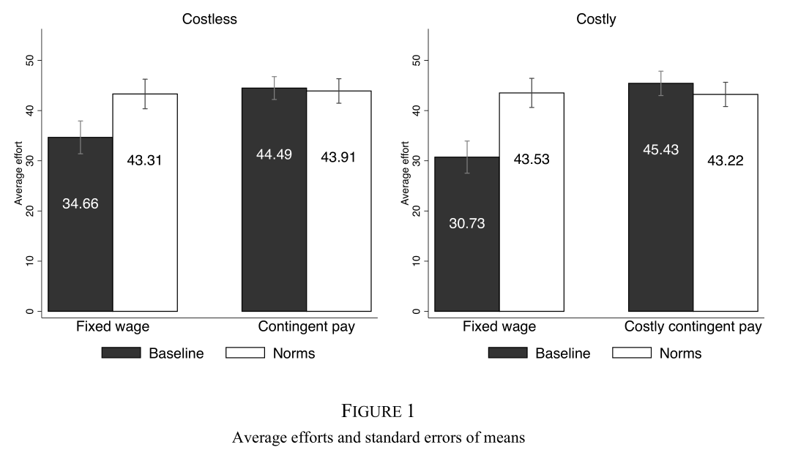
Results · Efforts Level

Slide 18
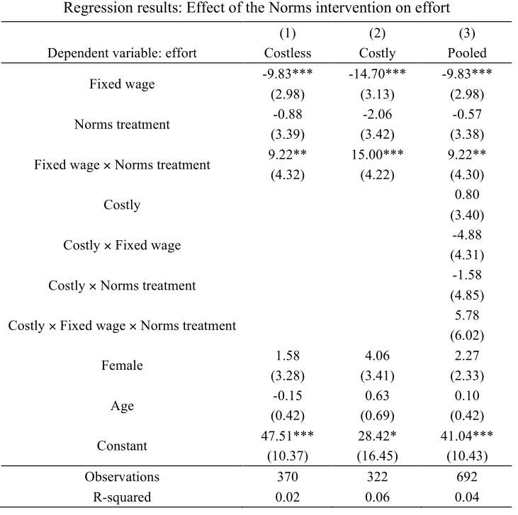
Results · Efforts Level

Slide 19
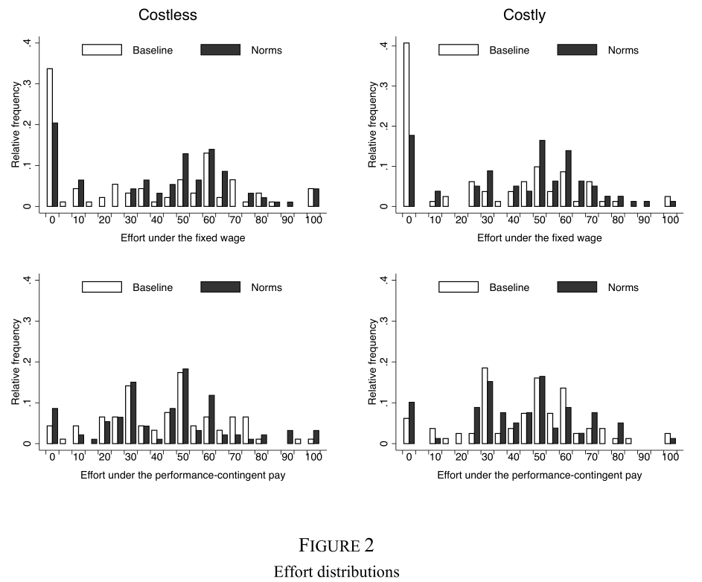
Results · Efforts Distribution

Slide 20
Mechanism · Three Premises
Agents
Information about
behavior of others
Agents
Beliefs about
behavior of others
Premise 2
Principals
Incentives choice
Premise 1
Premise 3
Agents
Efforts level
More information see Sliwka(2007)
Notes:
会按照premise 1 2 3 展开介绍

Slide 21
Mechanism · Agents’ Beliefs
Experiment 1: 16 out of the 25 sessions
Agents’ beliefs about the behavior of other agents under both contract types after the decision making stage
additional payoff equal to €2 minus €0.01 per unit of the squared deviation between their estimate and the true session mean of efforts
Notes:
没有负值激励

Slide 22
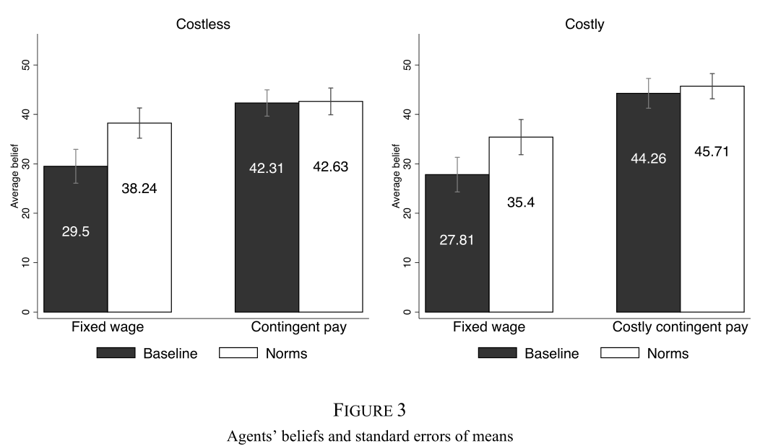
Mechanism · Agents’ Beliefs
Notes:
没有负值激励

Slide 23
Mechanism · Agents’ Beliefs
Experiment 2: separate (online) experiment
Outside observers received instructions from the Costless Norms treatment
We have randomly drawn one of the prior participants in the role of an employer. This employer has observed contributions of 10 employees from the prior experiment for both the trust and the contingent contract. This employer has chosen the [Treatment Contingent Pay Beliefs] contingent contract / [Treatment Fixed Wage Beliefs] trust wage after having seen the table of the form shown in the above. What is your best estimate about the average effort under the trust contract in the table above? What is your best estimate about the average effort under the contingent contract in the table above?
Result: third party beliefs are affected by contract choices
Notes:
avoid false consensus effects and self-serving beliefs
没有负值激励
担当 principal

Slide 24
Mechanism · Three Premises
Agents
Information about
behavior of others
Agents
Beliefs about
behavior of others
Premise 2
Principals
Incentives choice
Premise 1
Premise 3
Agents
Efforts level
More information see Sliwka(2007)
Notes:
会按照premise 1 2 3 展开介绍

Slide 25
Mechanism · Principals’ Contract Choice Behavior
Strategy method in six sessions of the Costly contract choice experiment : a different decision procedure
“雇主”看到五张不同的表格，每张都有上一回合10位“员工”在两种薪酬机制下不同的努力水平
其中只有一张表格在上一回合真实发生，但参与者不知晓哪一张是真实的表格
其中两张表格中下“雇主”收益在固定工资情形下高于灵活工资，其余三张相反。该信息“雇主”无法直接从表格中获取。
Baseline treatment: “员工”不知晓“雇主”已了解其他“员工”过往行为这件事，且“雇主”知晓以上信息。
Norms treatment: “员工”知晓“雇主”已了解其他“员工”过往行为这件事，且“雇主”知晓以上信息。
Notes:
更加贴合现实
增强真实感

Slide 26
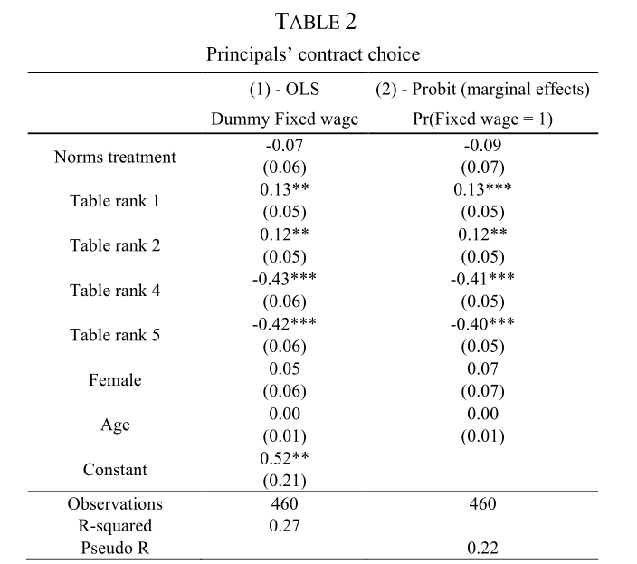
Mechanism · Principals’ Contract Choice Behavior
Notes:
avoid false consensus effects and self-serving beliefs
没有负值激励
担当 principal

Slide 27
Mechanism · Three Premises
Agents
Information about
behavior of others
Agents
Beliefs about
behavior of others
Premise 2
Principals
Incentives choice
Premise 1
Premise 3
Agents
Efforts level
More information see Sliwka(2007)
Notes:
会按照premise 1 2 3 展开介绍

Slide 28
Mechanism · Effects of Explicit Norms Disclosure
similar to our Costless Baseline treatment
Difference: agents see a table similar to the one in the Norms treatment with efforts of 10 selected employees from a previous experiment
Notes:
Whether information about others’ behavior affects agents’ effort choices

Slide 29
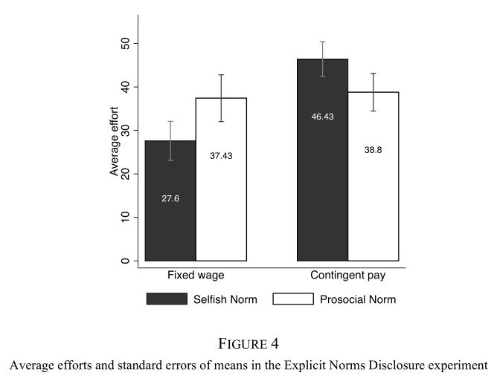
Mechanism · Effects of Explicit Norms Disclosure
Selfish Norm treatment and Prosocial Norm treatment agents
a sample of 10 selected agents with very high contributions under the fixed wage and the contingent contract respectively
Notes:
Whether information about others’ behavior affects agents’ effort choices

Slide 30
Mechanism · Three Premises
Agents
Information about
behavior of others
Agents
Beliefs about
behavior of others
Premise 2
Principals
Incentives choice
Premise 1
Premise 3
Agents
Efforts level
More information see Sliwka(2007)
Notes:
会按照premise 1 2 3 展开介绍

Slide 31
PART 4: Discussion
Extensions & Thoughts

Slide 32
Discussion: extention & thoughts
激励机制标准设置是否有待改进？--inner validity
策略性方法是否能有效模拟现实职场环境？--external validity
Charness, Gary , U. Gneezy , and A. Henderson . "Experimental methods: Measuring effort in economics experiments." Journal of Economic Behavior & Organization 149(2018):74-87.
是否有其他解释渠道？
Gift exchange theory Fehr,Kirchseiger, and Riedl(1993); Kube,Marechal, and Puppe(2012)
Trust, Reciprocal preference Berg et.al (1994): Trust, Peciprocity, and Social Histrory
Notes:
出让自己的部分利益—换取信任

Slide 33
Thanks for listening :)

